Slide 1
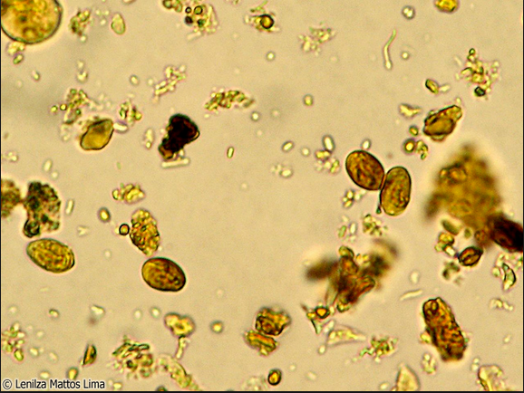
Giardia lamblia

Slide 2
Introduction
It is a flagellated parasite which causes Giardiasis.
It is cosmopolitian in distribution and is found in areas where water supplies and environment becomes faecally contaminated.
It passes its life cycle in a single host.

Slide 3
Consist of two stages:trophozoite and cyst
Trophozoite
-it is pear shaped flagellate which is motile and attached by sucking discs to epithelial cells in small intestine (duodenum and jejunum).
- It has 4 pairs of flagella, 2 axoneme and 2 nuclei.
Cyst
It is formed by encystment of trophozoite in colon.
The cyst is thick walled with 4 nuclei and several internal fibres.
Each cyst gives rise to 2 trophozoites during excystment in the intestinal tract.

Slide 4
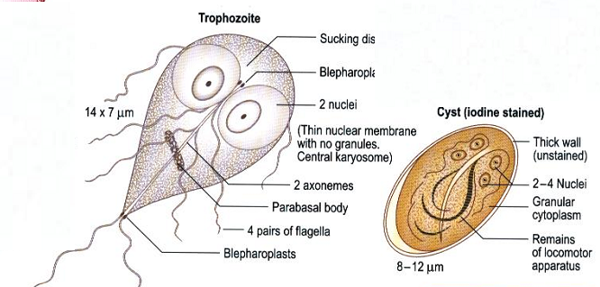

Slide 5
Transmission and life cycle
Giardia is transmitted from faeco-oral route.
Direct transmission is also common in childrens and in homosexuals.
Life cycle
After ingestion of giardia cyst in food and water, the cyst undergo excystment in duodenum.
The cyst then hatches out to become two trophozoite which divide, multiply and colonize in the duodenum and upper part of jejunum.
During unfavourable condition, the trophozoite encyst in colon and is passed out into the stool as cyst. The cycle is thus repeated.

Slide 6
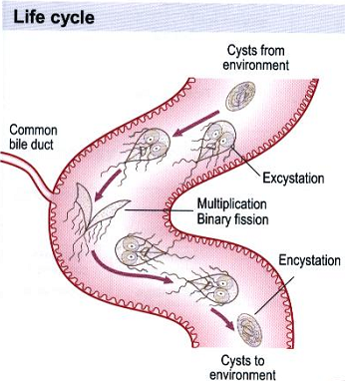
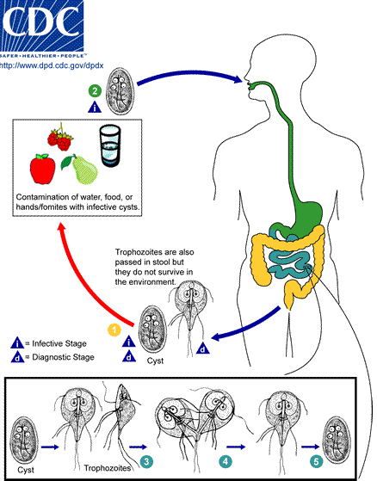

Slide 7
Pathogenicity
Incubation period: 1-3 weeks
It causes giardiasis
After inhalation of cyst the excystation occur in the duodenum , where the trophozoits releases and attach to the gut wall but does not invade.
The trophozoite cause inflammation of duodenal mucosa leading to malabsorption of fat and proteins.
There is mechanical blockage of intestinal mucosa by large number of giardia trophozoites.
Similarly the brush border of microvilli is damaged by parasite’s sucking disc.

Slide 8
Clinical manifestation
In endemic situation 2/3rd of the infected patients are assymptomatic.
In acute case, the symptoms include diarrhoea and the stool is foul smelling, greasy in appearance and floats on water.
It is devoid of blood or mucus.
Other symptoms includes upper abdominal cramp, excessive gas, abdominal distension, nausea, vomitting with low grade fever.
In many adults, acute phase is followed often by subacute or chronic phase which is characterised by intermittent bouts of mushy stools, flattulence, weight loss.

Slide 9
Lab diagnosis
Sample: faecal specimen
Multiple stool samples (at least 3) should be tested before a negative result is reported.
Macroscopy:-Stool offensive odour, pale coloured, fatty and float in water.
Microscopy: diagnosis is made by finding the cyst in formed stool or the trophozoite in diarrhoeal stools, duodenal secretion or jejunal biopsy specimen.
Wet mount technique:-
In bright-field microscopy, cysts appear ovoid to ellipsoid in shape and usually measure 11 to 14 µm (range: 8 to 19 µm). Immature and mature cysts have 2 and 4 nuclei, respectively. Intracytoplasmic fibrils are visible in cysts

Slide 10
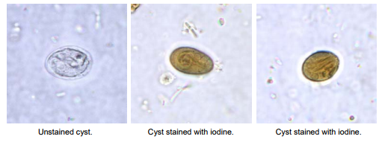

Slide 11
Trichrome staining, Giemsa or Field’s staining and observed under microscope.
String test: here a weighted piece of string having gelatin capsule on the end is swollowed untill it reaches the duodenum pulled after 4 hrs. The trophozoite attaches to the string which can visualised microscopically.
Serological test:
Direct fluorescent antibody (DFA) assay, Enzyme immunoassay (EIA), Rapid immunochromatographic cartridge assays.
detection of giardia specific antigen in fecal specimen using monoclonal antibody reagent
Giardia strip:It is rapid and simple immunochromatographic strip and detect membrane antigen of giardia cyst in unconcentrated feaces.

Slide 12
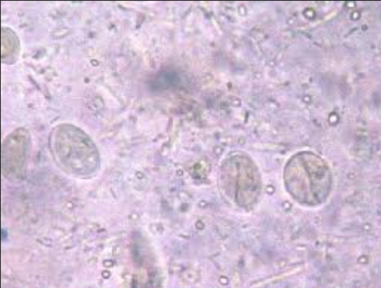
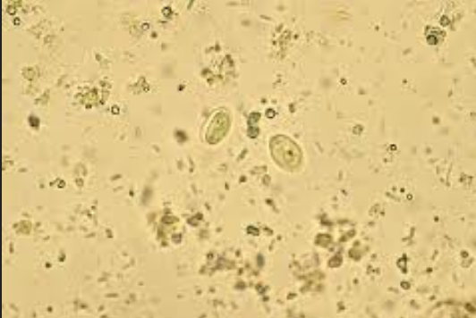
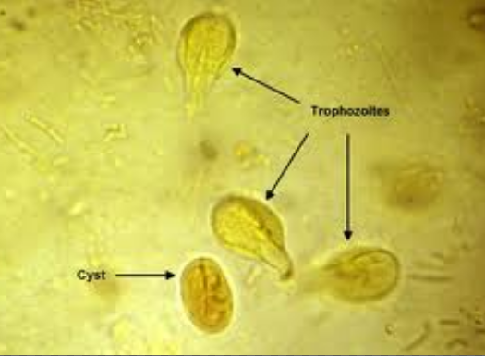
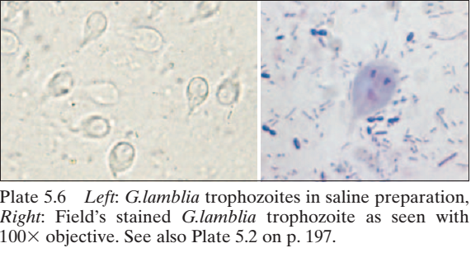
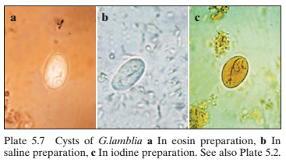

Slide 13
Treatment
Standard treatment for giardiasis is antibiotic therapy.
Metronidazole is the drug of choice
Appropriate fluid and electrolyte in the case of large-volume diarrheal losses.

